Slide 1
CS 3006 Parallel and Distributed Computing Lecture 1
Danyal Farhat
FAST School of Computing
NUCES Lahore

Slide 2
Course Overview

Slide 3
Outline
Students’ Background
Few Basic Questions
Instructor's Background
Classroom Etiquettes
Tentative Grading Policy
Administrative Information

Slide 4
Outline (Cont.)
Course Learning Outcomes
Textbooks
Reference Books
Aim of the Course
Tentative Course Outline
Summary

Slide 5
Students’ Background
FSC / A Level / ICS?
College?
Home Town?
CGPA? (Optional)

Slide 6
Few Basic Questions
What is parallel computing?
What is distributed computing?
What is parallel and distributed computing?
Applications that use parallel and distributed computing?

Slide 7
Few Basic Questions (Cont.)
What is parallel computing?
Multiple processors or cores working in parallel as part of one integrated system.
Normally, on a single geographical location with no network involved.
What is distributed computing?
Multiple autonomous computers working together as part of one integrated system.
Dispersed on multiple geographical locations connected with the help of network.

Slide 8
Few Basic Questions (Cont.)
What is parallel and distributed computing?
Combination of both parallel and distributed computing.
Applications that use parallel and distributed computing?
Google Search Engine, Facebook, Netflix and many others.

Slide 9
Instructor’s Background
CS Lecturer – FAST NUCES LHR
Computer Networks (CS Core) – Fall 23
Parallel and Distributed Computing (CS Core) – Fall 23
Introduction to Cloud Computing (CS Elective) – Summer 23
Parallel and Distributed Computing (CS Core) – Spring 23
Introduction to Cloud Computing (CS Elective) – Spring 23

Slide 10
Instructor’s Background
Cloud Specialist, Multilynx
Worked as cloud specialist in Multilynx cloud support on Jazz’s Garaj cloud services project.
Ability to handle all sorts of customers from day-one (no prior training require) on VMware vSphere and Microsoft Azure cloud platforms.
Public cloud management on VMware vSphere (vCloud Director 10.2, vCenter 7, vRealize Operations 8.2, and NSX-T 3.0).

Slide 11
Instructor’s Background (Cont.)
Cloud Specialist, Multilynx
Providing managed services (like Windows, Linux, Ubuntu, and RedHat OS level support along with web-hosting and database server configurations) to cloud tenants.
Interactions with internal teams to ensure Unified Threat Management (UTM) enablement, IP Sec VPN, Multiprotocol Label Switching (MPLS), and Session Initiation Protocol (SIP) connectivity for cloud tenants.

Slide 12
Instructor’s Background (Cont.)
Cloud Specialist, Multilynx
Providing managed services related to security like Endpoint Detection and Response (EDR), Qualys agent installation and management (vulnerabilities detection and recommended solution), and Linux Security Information and Event Management (SIEM) configurations for SOC team to ensure cloud infrastructure security.
Public cloud logs tracking using Jira for smooth operations of cloud services.
Jira - Issues and project tracking software used in software development and cloud environment

Slide 13
Instructor’s Background (Cont.)
AM Network Support – Cloud Operation, PTCL
Public Cloud management on platforms like VMware vSphere, Microsoft Azure Stack and Microsoft Hyper-V.
Interact with stakeholders (tenants, data center, transmission, network, and business teams) to ensure coordinated operations management of cloud services and to provide technical details relating to cloud services platforms and their comparisons as per clients’ services requirements.

Slide 14
Instructor’s Background (Cont.)
AM Network Support – Cloud Operation, PTCL
Supervise process of configuration management, patch management and vulnerability assessment across cloud infrastructure to ensure security, governance, and compliance objectives of the department.
Ensure process improvement, documentation and audit activities related to different certifications i.e. Payment Card Industry Data Security Standard (PCI DSS), Telecommunications Industry Standard (TIA-942) and ISO/IEC 22237, for cloud and NOC functions, catering both current and future needs.

Slide 15
Instructor’s Background (Cont.)
AM Network Support – Data Center, PTCL
Worked in TIA-942 certified Tier-3 co-location data center on Schneider Electric infrastructure and on Juniper networks.
Provide assistance in managing the Shell part of Data Center which includes BMS monitoring, Access Control systems, Heating, Ventilation, and Air Conditioning (HVAC) system, Very Early Smoke Detection Apparatus (VESDA) system, and Power Management Module (PMM) for data centers.
Involved in the HP ProLiant servers configurations during cloud infrastructure deployment.

Slide 16
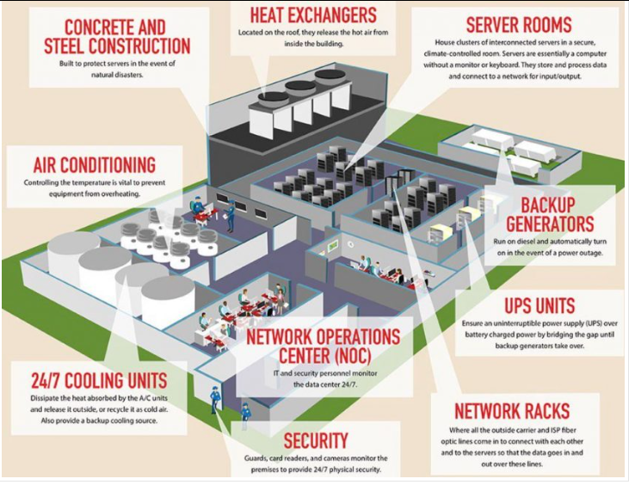
Data Center Building Management System

Slide 17
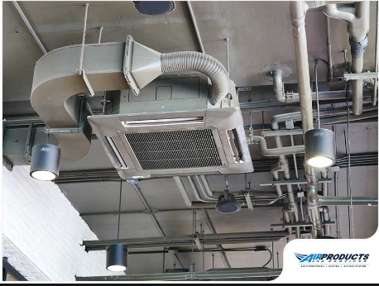
Heating Ventilation and Air Conditioning (HVAC)

Slide 18
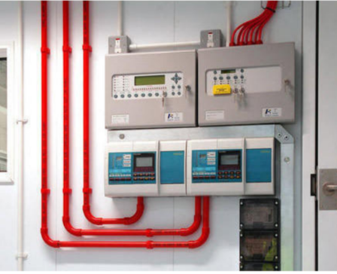
Very Early Smoke Detection Apparatus (VESDA)

Slide 19
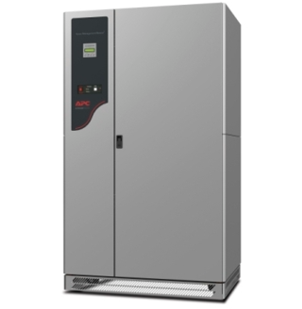
Power Management Module (PMM) – 150 kVA

Slide 20
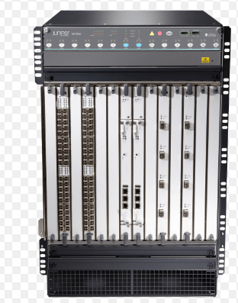
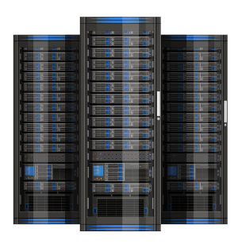
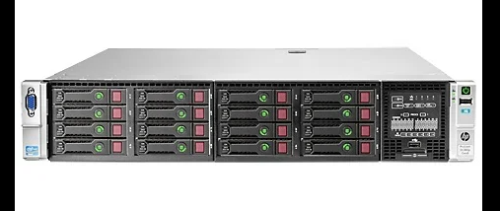
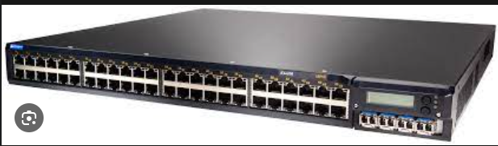
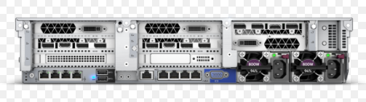
Data Center Components
MX 960 Router
Rack
Server Front
EX 4200 Switch
Server Back

Slide 21
Instructor’s Background (Cont.)
Management Trainee, PTCL
Worked in traffic shaping implementation using pipes in Free BSD OS.
Worked on project to identify company’s grey areas and to suggest strategies to remove or lesson those areas.
Attended trainings on Dashboard Reporting with MS Excel, Business Process Improvement and Re-engineering, Fire Safety and Emergency Response, Developing Effective Strategist, and Data Center Maintenance.
Provide presentations on
CRM of Call Centers
Carrier and Wholesale Services
Digital Services
After Sales Services

Slide 22
Instructor’s Background (Cont.)
Certifications
Microsoft Certified: Azure Fundamentals
Microsoft Certified: Azure Administrator Associate
Fortinet - NSE 1 Network Security Associate
Fortinet - NSE 2 Network Security Associate
Fortinet - NSE 3 Network Security Associate
Lean Six Sigma Green Belt Certification

Slide 23
Instructor’s Background (Cont.)
Badges
AWS Academy Educator
CCNA: Introduction to Networks
CCNA: Switching, Routing, and Wireless Essentials
CCNA: Enterprise Networking, Security, and Automation

Slide 24
Instructor’s Background (Cont.)
Master of Science – Computer Science – UCP LHR
Thesis: Cyber Risk Modelling for Ransomware Attacks in Business Sectors [Implemented in R]
The purpose of the work was to propose and implement a generalized mathematical model (consisting of parameters, mathematical equations and Monte Carlo simulation) for cyber risk estimation of ransomware attacks on personal computers of different organization categories (micro, small, medium, large, and giant) and for different industrial sectors (information technology, finance, retails and other).

Slide 25
Instructor’s Background (Cont.)
Master of Science – Computer Science – UCP LHR
Publications: D. Farhat and M.S. Awan, "A Brief Survey on Ransomware with the Perspective of Internet Security Threat Reports," IEEE Xplore, 9th International Symposium on Digital Forensics and Security (ISDFS), 28-29 Jun, 2021.

Slide 26
Instructor’s Background (Cont.)
Bachelor of Science – Computer Science FAST NUCES ISB
FYP: AWD Analyzer [Implemented in Python and ASP.NET]
The web interface that provided analytical feedback based on user reviews and product’s specifications. It scraped reviews data from different websites (under legal constraints) and provided feedback using sentiment analysis by implementing bag of words and random forests algorithms.

Slide 27
Classroom Etiquettes
80% attendance is mandatory
Students participation in the class is mandatory
Talking among each other is not appreciated
If a key term is confusing to you, raise hand and ask the instructor
Cases of plagiarism will lead to marks and/or grade reduction

Slide 28
Tentative Grading Policy
Course grades will be based on absolute grading
Quizzes → 10%
3 to 4, Announced, no retake, may be best-of quizzes
Assignments → 10%
3 to 4, Announced, no retake, may be best-of assignments
Course Project → 10%
Research based project
Midterm I and Midterm II → 30%
Final Exam → 40%
Comprehensive exam (all course contents included)

Slide 29
Administrative Information
Office
Office 55, First Floor, New CS Building
Email
danyal.farhat@lhr.nu.edu.pk
Office Hours
TBD
Website
Classroom Code (PDC BCS 6G): dtv37hr
Classroom Code (PDC BCS 6H): ykspnw5
Classroom Code (PDC BDS 6A): edkgmo4

Slide 30
Course Learning Outcomes (CLOs)
Demonstrate understanding of various concepts involved in parallel and distributed computer architectures
Implement different parallel and distributed programming paradigms and algorithms using Message-Passing Interface (MPI) and OpenMP
Perform analytical modelling, dependence, and performance analysis of parallel algorithms and programs

Slide 31
Textbooks
Introduction to Parallel Computing by Ananth Grama and Anshul Gupta
Distributed Systems: Concept and Design by George Coulouris, Gordon Blair
Using OpenMP: Portable Shared Memory Parallel Programming by Barbara Chapman, Gabriele Jost, Ruud van der Pas.

Slide 32
Reference Books
Distributed Systems: Principles and Paradigms, A. S. Tanenbaum and M. V. Steen,Prentice Hall, 2nd Edition, 2007.
Distributed and Cloud Computing: Clusters, Grids, Clouds, and the Future Internet, K Hwang, J Dongarra and GC. C. Fox, Elsevier, 1st Ed.

Slide 33
Aim of the Course
To understand the fundamental concepts of parallel and distributed computing
Design and analysis of parallel algorithms
Analyze different problems and develop parallel programming solutions of those problems
Study the challenges of Parallel and Distributed systems and how to cope with them

Slide 34
Tentative Course Outline
Course Overview
Introduction to Parallel and Distributed Computing
Amdahl’s law and Karp-Flatt Metric
Flynn’s Classical Taxonomy and Processor to Memory Connection Strategies
Network Topologies for Parallel Architectures, Evaluating Static Inter-Connection in Terms of Cost, Diameter, Bisection Width, and Arc Connectivity

Slide 35
Tentative Course Outline (Cont.)
Principles of Parallel Algorithm Design, Task Dependency Graphs, Granularity and Concurrency, Task Interaction Graphs
Programming Shared Address Space Platforms using POSIX Thread API
Shared Memory Programming with OpenMP
Synchronization Constructs in OpenMP
Decomposition and Mapping Techniques

Slide 36
Tentative Course Outline (Cont.)
Introduction to Distributed Systems
Types of Distributed System Architecture
Distributed Operating Systems
Types of Distributed Systems
Cluster Computing
Grid Computing
Cloud Computing

Slide 37
Tentative Course Outline (Cont.)
Basic Communication Operations
One-to-All Broadcast
All-to-One Reduction
All-to-All Broadcast
All-to-All Reduction
All Reduce
Prefix Sum
Scatter and Gather
All-to-All Personalized (Total Exchange)
Programming Distributed Machines Using Message Passing Interface (MPI)

Slide 38
Tentative Course Outline (Cont.)
Fault Tolerance Techniques: Hardware Redundancy, Time Redundancy, Information Redundancy
Distributed File System, HDFS, MapReduce, Yarn
Remote Procedure Calls
Web Services
Logical Clocks and Vector Clocks
RAFT - A Consensus Algorithm for Replicated Log
Course Project Presentations

Slide 39
Summary
Students’ Background
Few Basic Questions
Instructor's Background
Cloud Platforms - VMware vSphere, AWS, MS Azure Stack, and MS Hyper-V
Networking Domain - IP Sec VPN, MPLS, and SIP connectivity
Security Domain - UTM, EDR, Qualys and SIEM Integration
Management Domain - Jira, Lean Six Sigma
Industry Standards - PCI DSS, TIA-942, ISO/IEC 22237

Slide 40
Summary (Cont.)
Instructor's Background (Cont.)
Data Center Building Management System (BMS)
Heating Ventilation and Air Conditioning (HVAC)
Very Early Smoke Detection Apparatus (VESDA)
Power Management Module (PMM) – 150 kVA
Data Center Components

Slide 41
Summary (Cont.)
Classroom Etiquettes
Attendance
Students Participation
Tentative Grading Policy
Absolute Grading
Administrative Information
Course Learning Outcomes
Concepts of Parallel and Distributed Computing
Programming Paradigms - Pthread, OpenMP, and MPI
Analytical Modelling, Algorithm dependence, and Performance Analysis

Slide 42
Summary (Cont.)
Textbooks
Reference Books
Aim of the Course
Fundamental Concepts of Parallel and Distributed Computing
Design and Analysis of Parallel and Distributed Algorithms
Challenges of PDC and their Recommended Solutions
Tentative Course Outline

Slide 43
Questions?

